Slide 1







Early Default Prediction Model for Credit Card Risk Assessment
Early Default Prediction Model for Credit Card Risk Assessment
OPIM-5512-DATA SCIENCE WITH PYTHON-SECB13-1238
FINAL PRESENTATION
TEAM MEMBERS:
CHETAN KHATRI SANCHITA GODSE CHIRAG PHALGUNE SREENIDHI CHINTALA
ARVIND DEVULAPALLI
OPIM-5512-DATA SCIENCE WITH PYTHON-SECB13-1238
FINAL PRESENTATION
TEAM MEMBERS:
CHETAN KHATRI SANCHITA GODSE CHIRAG PHALGUNE SHREENIDHI CHINTALA
ARVIND DEVULAPALLI

Slide 2
AGENDA:
INTRODUCTION
DATA DESCRIPTION
DATA CLEANING AND PREPROCESSING
VISUALISATIONS AND INSIGHTS
DATA MODELLING
Model 1- Use all the features
Model 2 - Remove Highly Correlated features
Model 3 - Removed both Bill_Amount_month and Pay_Month as the are highly correlated
Model 4 - Principal Component Analysis
RESULTS COMPARISON
RECOMMENDATION

Slide 3
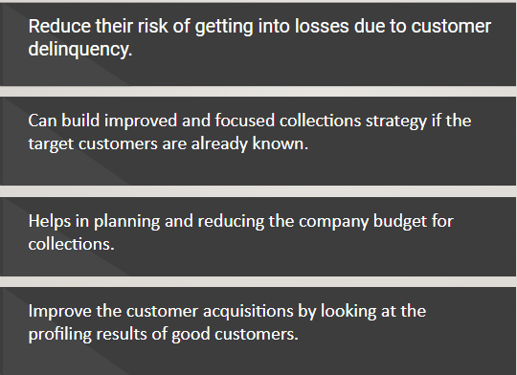
OBJECTIVE:
The credit card company in Taiwan faces significant financial repercussions when customers default on their credit card payments. Defaulted accounts result in the closure of the credit card accounts and the write-off of outstanding balances as bad debt. These bad debts are often sold to collections agencies at a fraction of their original value, causing substantial financial losses. Currently, the company relies on a three-month grace period before acting on delinquent accounts. However, this approach has limitations, as some customers may default before this period, leading to increased losses.

Slide 4
DATA DESCRIPTION:
The first group of variables contains information about the **client personal information**:
1. `ID`: ID of each client, categorical variable
2. `LIMIT_BAL`: Amount of given credit in NT dollars (includes individual and family/supplementary credit)
3. `SEX`: Gender, categorical variable (1=male, 2=female)
4. `EDUCATION`: level of education, categorical variable (1=graduate school, 2=university, 3=high school, 4=others, 5=unknown, 6=unknown)
5. `MARRIAGE`: Marital status, categorical variable (1=married, 2=single, 3=others)
6. `AGE`: Age in years, numerical variable
The following attributes contains information about the **delay of the past payment** referred to a specific month:
1. `PAY_0`: Repayment status in September 2005 (-1=pay duly, 1=payment delay for one month, 2=payment delay for two months, … 8=payment delay for eight months, 9=payment delay for nine months and above)
2. `PAY_2`: Repayment status in August 2005 (same scale as before)
3. `PAY_3`: Repayment status in July 2005 (same scale as before)
4. `PAY_4`: Repayment status in June 2005 (same scale as before)
5. `PAY_5`: Repayment status in May 2005 (same scale as before)
6. `PAY_6`: Repayment status in April 2005 (same scale as before)
Other variables instead consider the information related to the **amount of bill statement** (i.e., a monthly report that credit card companies issue to credit card holders in a specific month): 1. `BILL_AMT1`: Amount of bill statement in September 2005 (NT dollar)
2. `BILL_AMT2`: Amount of bill statement in August 2005 (NT dollar)
3. `BILL_AMT3`: Amount of bill statement in July 2005 (NT dollar)
4. `BILL_AMT4`: Amount of bill statement in June 2005 (NT dollar)
5. `BILL_AMT5`: Amount of bill statement in May 2005 (NT dollar)
6. `BILL_AMT6`: Amount of bill statement in April 2005 (NT dollar)
The following variables instead consider the **amount of previous payment** in a specific month: 1. `PAY_AMT1`: Amount of previous payment in September 2005 (NT dollar)
2. `PAY_AMT2`: Amount of previous payment in August 2005 (NT dollar)
3. `PAY_AMT3`: Amount of previous payment in July 2005 (NT dollar)
4. `PAY_AMT4`: Amount of previous payment in June 2005 (NT dollar)
5. `PAY_AMT5`: Amount of previous payment in May 2005 (NT dollar)
6. `PAY_AMT6`: Amount of previous payment in April 2005 (NT dollar)
The data has been sourced from https://www.kaggle.com/datasets/uciml/default-of-credit-card-clients-dataset

Slide 5
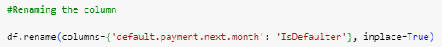
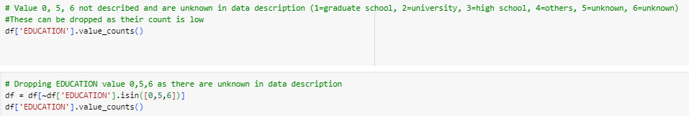
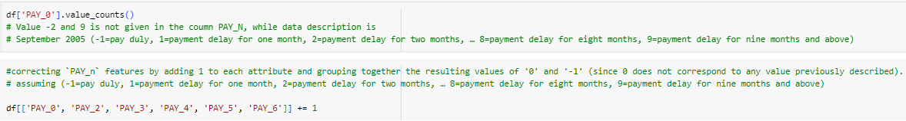
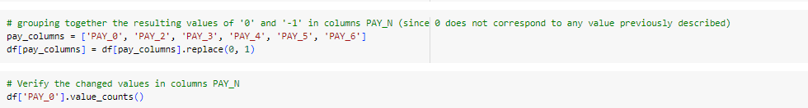
DATA CLEANING AND EXPLORATIONS:
Renaming columns
Dropping some values not defined in data description.

Slide 6
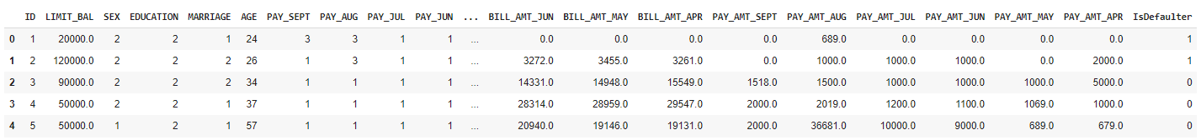
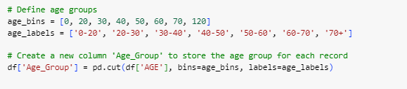
CLEANED DATA:
For the sake of visualizations and exploration on data the age column was grouped as below:

Slide 7
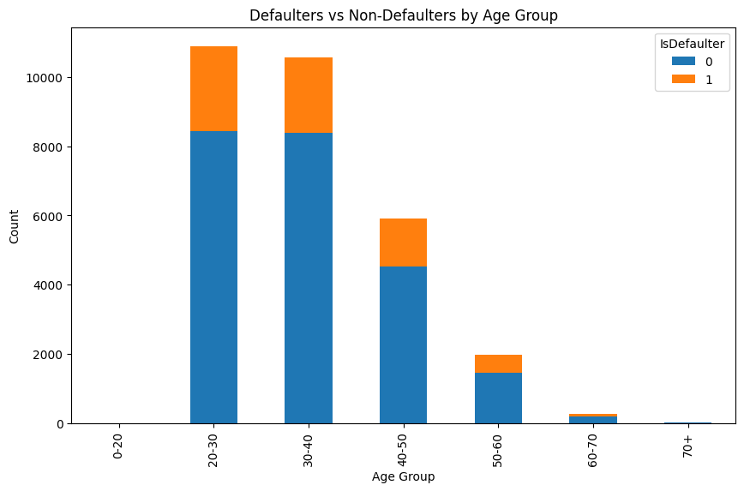
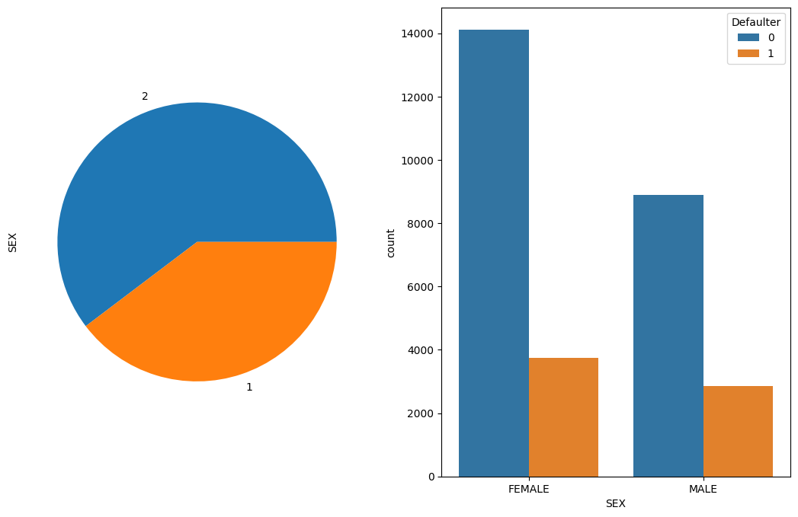
DATA VISUALISATIONS:
The 20-30 age group has the highest credit activity, the 40-50 group shows a higher default rate, and individuals over 50 have significantly lower counts of defaulters, possibly due to reduced credit usage or greater financial stability.
Taking the ratio between men and women defaulters and non-defaulter, it becomes evident that men have a higher tendency to be defaulters when compared to women.
Notes:
The largest number of individuals, both defaulters and non-defaulters, fall within the 20-30 age group. This suggests that this age group is the most active or the largest in terms of credit activity.
The 40-50 age group has the second-highest count of individuals, but interestingly, the proportion of defaulters within this age group is slightly higher than in the 30-40 age group. This could indicate a higher risk of default in the 40-50 age demographic.
There is a significant drop in the count of both defaulters and non-defaulters after the age of 50. Notably, for individuals aged 60 and above, the number of defaulters is very low compared to younger age groups. This could be due to various factors such as lower credit usage or better financial stability in later life stages.

Slide 8
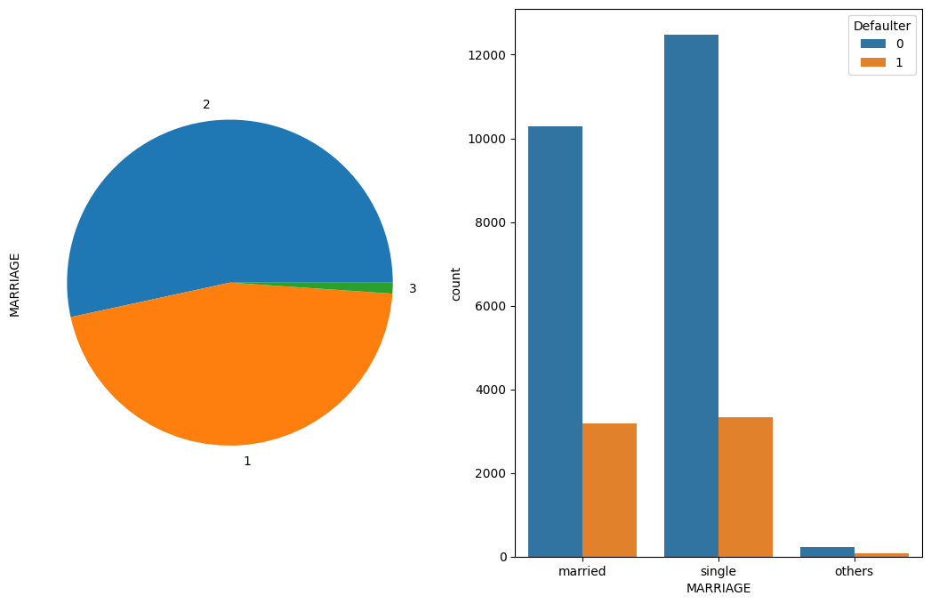
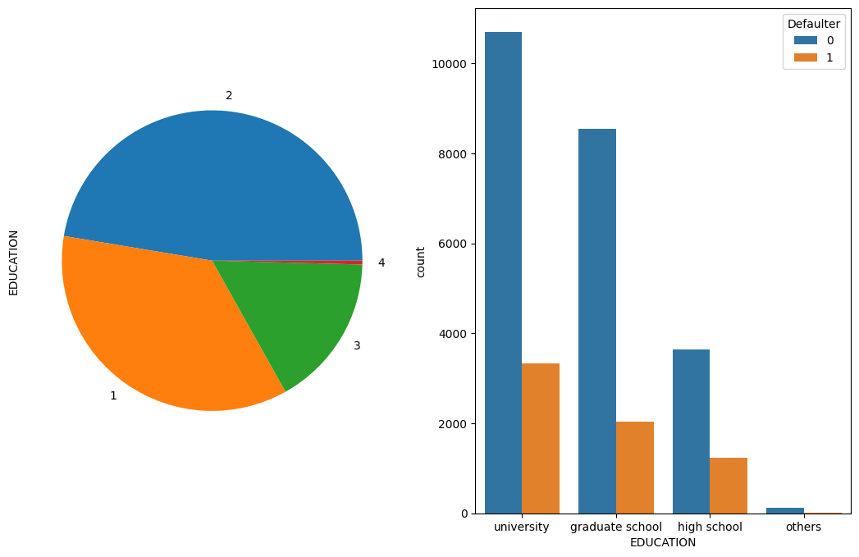
Married people tend to be more delinquent compared to single people.
No apparent difference is observed between the level of education and delinquent customers.

Slide 9
DATA MODELLING
Model 1- Use all the features
NOTE: Id and Age-group is removed for all models

Slide 10
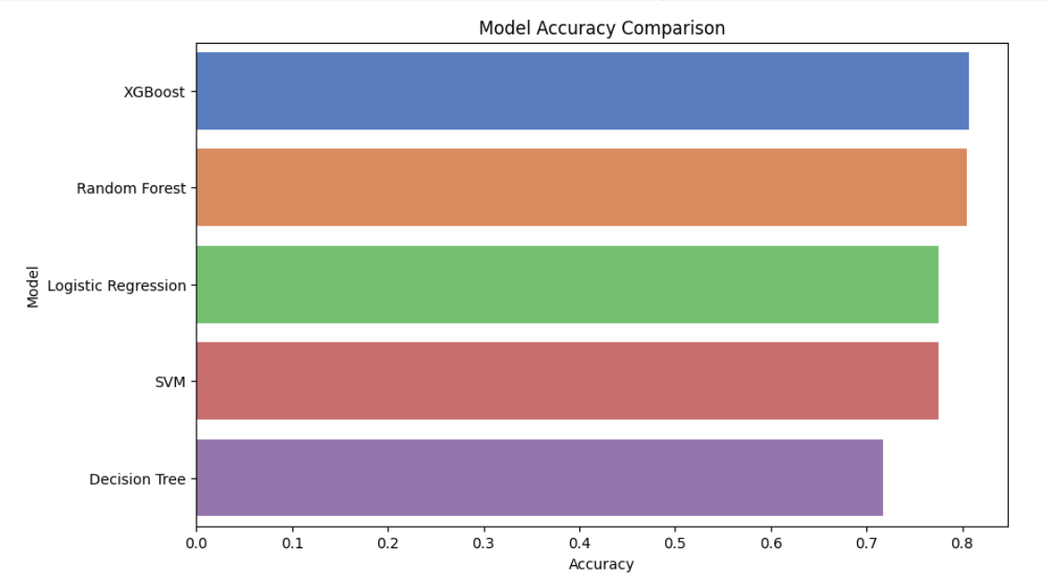
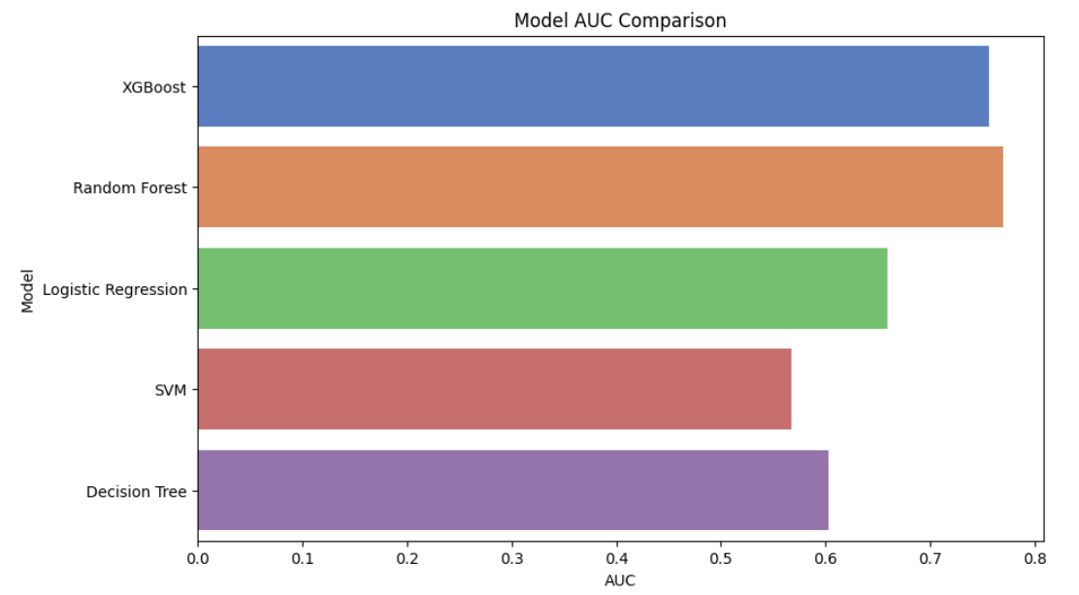
MODEL 1:
The accuracy comparison chart reveals that XGBoost outperforms other models in credit card fraud detection, with ensemble methods like Random Forest also proving effective. Simpler models like Decision Trees show lower accuracy, suggesting that complex patterns in the data require more advanced algorithms.
The AUC comparison chart illustrates that XGBoost and Random Forest have the highest Area Under the Curve (AUC), indicating superior performance in distinguishing between the classes. Decision Trees have the lowest AUC, suggesting they may not be as effective in this classification task.

Slide 11
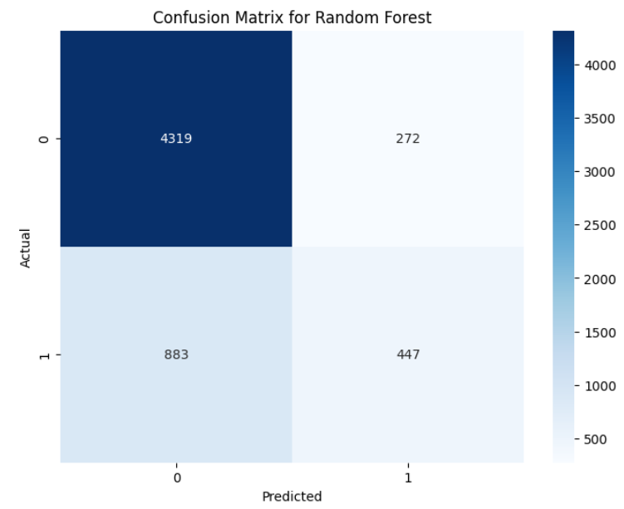
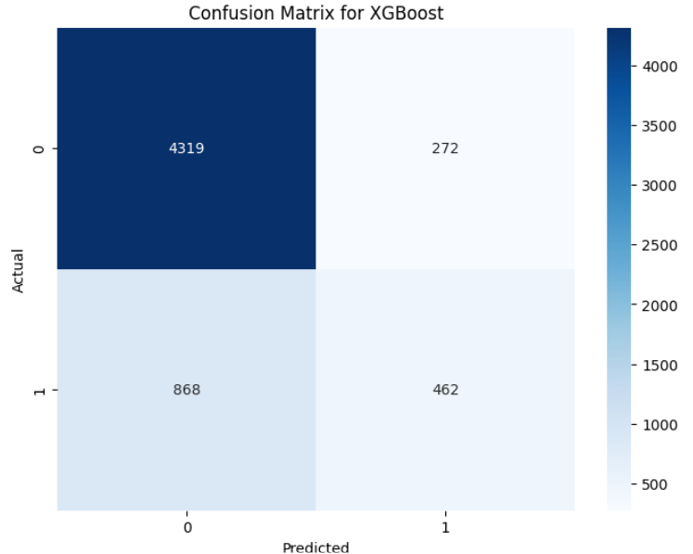
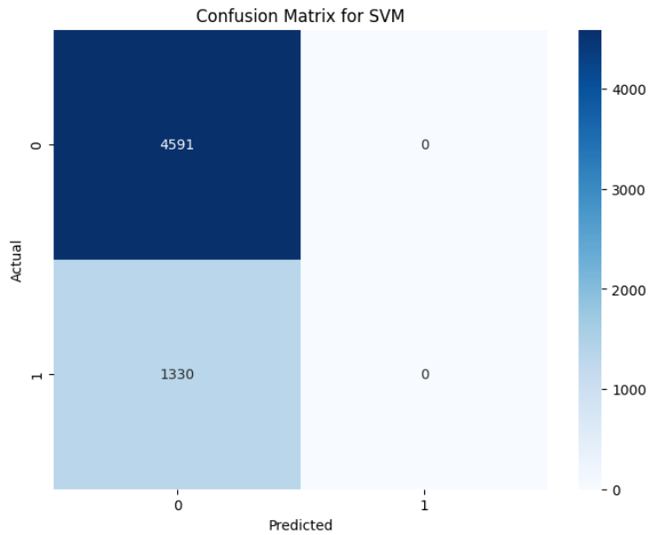
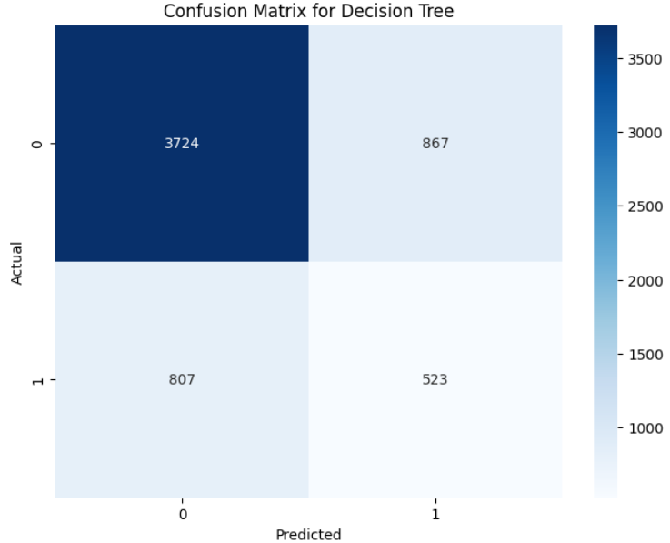
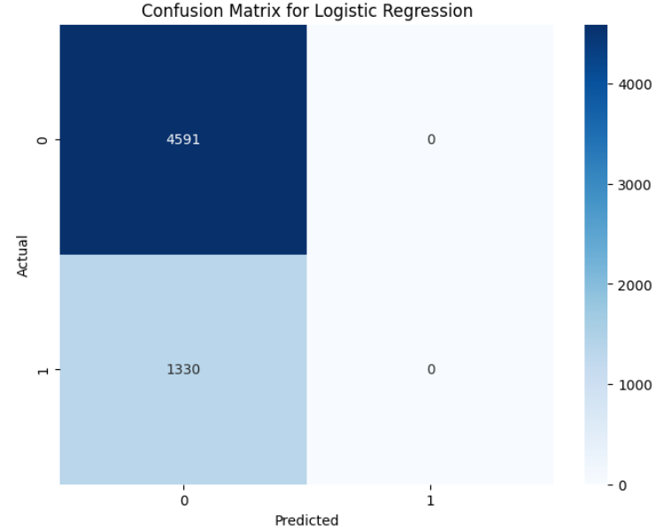
CONFUSION MATRIX:
Based on the provided confusion matrices, XGBoost appears to be the best performing model, as it has the highest number of true positives (462) and the least number of false negatives (868) for the positive class (1).

Slide 12
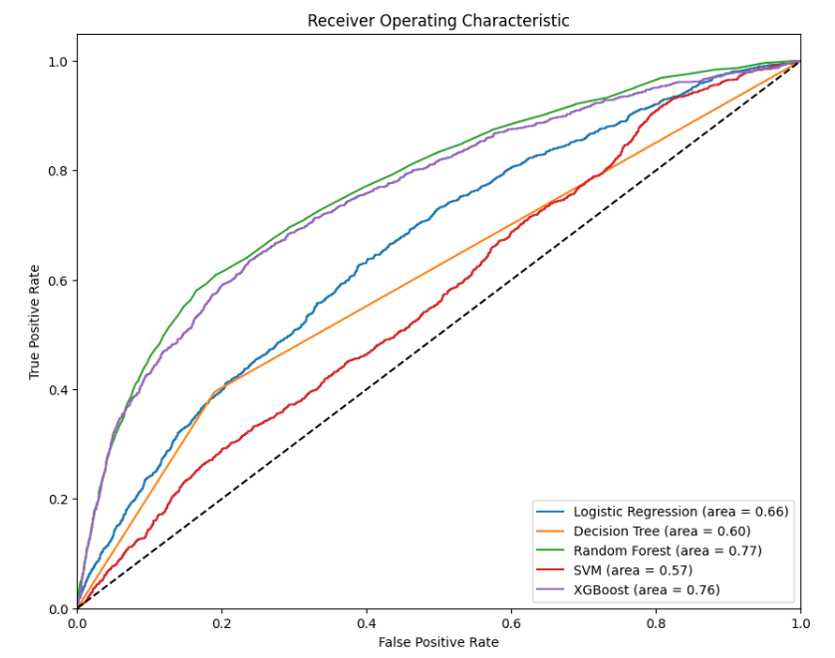
MODEL 1:
The ROC curve evaluates model performance:
1. Random Forest leads (AUC: 0.77), indicating the highest distinction between classes.
2. XGBoost is a close second (AUC: 0.76).
3. Logistic Regression (AUC: 0.66) and Decision Tree (AUC: 0.60) show moderate performance.
4. SVM lags (AUC: 0.57), barely above random chance.
Higher AUC values signify better model performance.

Slide 13
DATA MODELLING
Model 2 - Remove Highly Correlated features

Slide 14
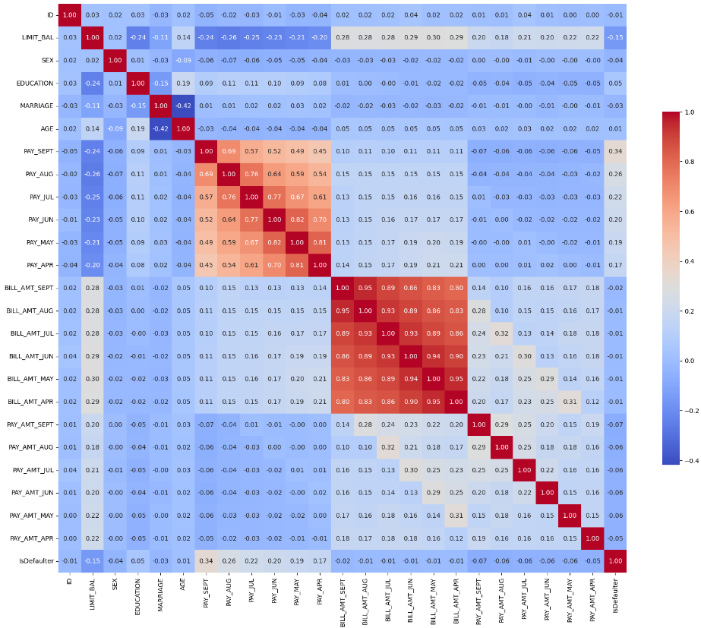
Correlation Analysis:
The correlation matrix shows strong positive correlations between the BILL_AMT features (BILL_AMT1 through BILL_AMT6) indicating that the amount of bill statement is highly correlated across successive months.
The PAY_AMT features (PAY_AMT1 through PAY_AMT6) related to previous payments also show moderate to strong correlations with each other, suggesting consistency in the amounts paid by customers over time.
Removed both Bill_Amount_month and Pay_Month as the are highly correlated.

Slide 15
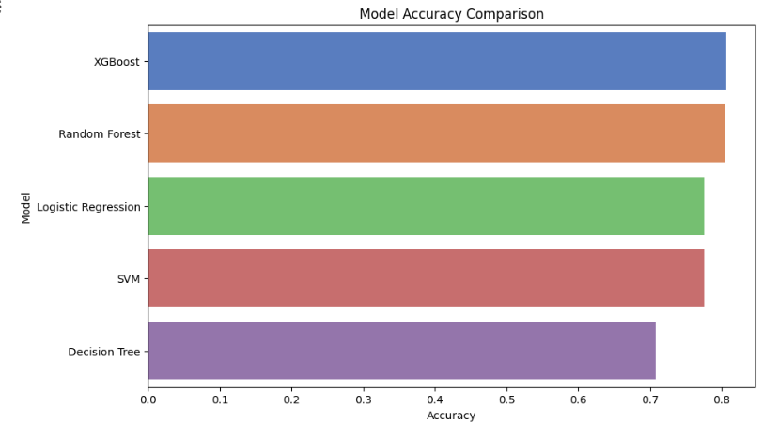
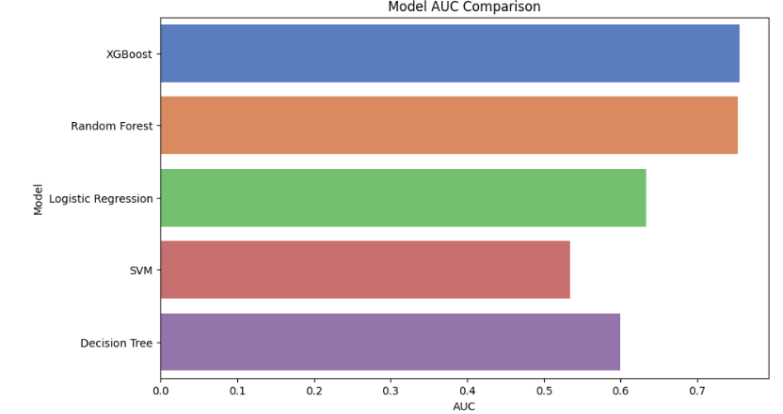
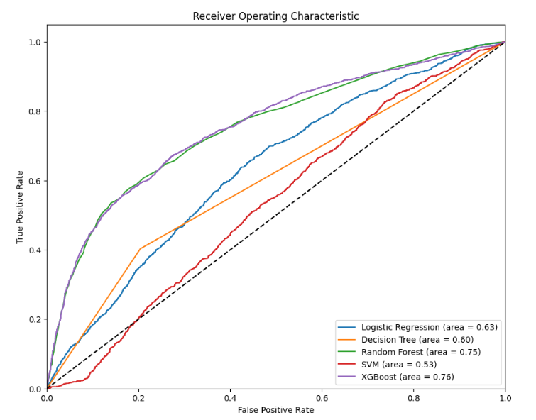
MODEL 2:
The accuracy comparison chart reveals that XGBoost outperforms other models in credit card fraud detection, with ensemble methods like Random Forest also proving effective. Simpler models like Decision Trees show lower accuracy, suggesting that complex patterns in the data require more advanced algorithms.
The AUC comparison chart illustrates that XGBoost and Random Forest have the highest Area Under the Curve (AUC), indicating superior performance in distinguishing between the classes. Decision Trees have the lowest AUC, suggesting they may not be as effective in this classification task.
ROC Curve Analysis:
XGBoost excels with the highest AUC (0.76), optimal for positive class identification.
Random Forest shows robust performance (AUC: 0.75), close to XGBoost.

Slide 16
DATA MODELLING
Model 3 - Removed both Bill_Amount_month and Pay_Month as the are highly correlated

Slide 17
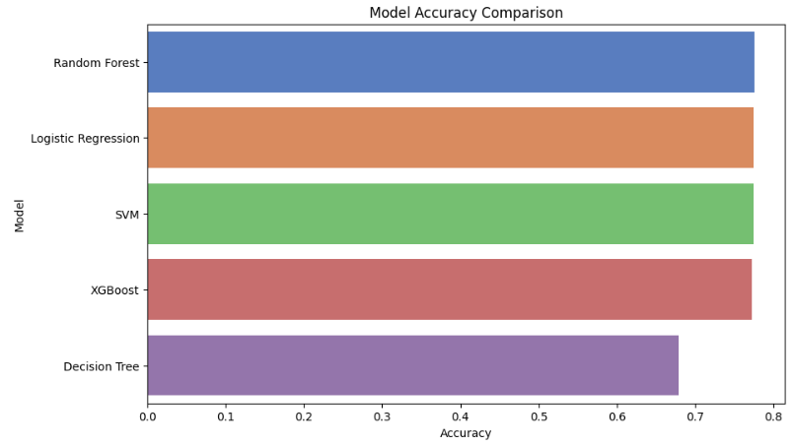
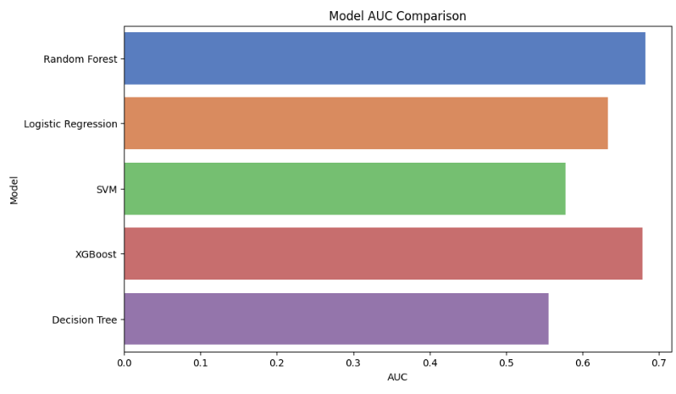
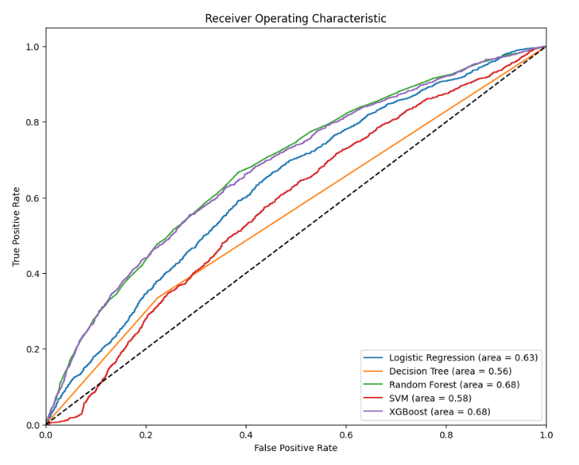
MODEL 3:
The bar chart shows that Random Forest is the top-performing model in terms of accuracy, followed closely by Logistic Regression. SVM, XGBoost, and Decision Tree models exhibit lower accuracy in comparison, with the Decision Tree showing the least accuracy among the evaluated models.
The AUC comparison chart illustrates that XGBoost and Random Forest have the highest Area Under the Curve (AUC), indicating superior performance in distinguishing between the classes. Decision Trees has the lowest AUC, suggesting they may not be as effective in this classification task.
ROC Curve Analysis:
XGBoost and Random Forest both present an AUC of 0.68, indicating comparable performance in true and false positive rates.
Logistic Regression follows with an AUC of 0.63, suggesting decent predictive ability but not as strong as the ensemble models.

Slide 18
DATA MODELLING
Model 4 - Principal Component Analysis

Slide 19
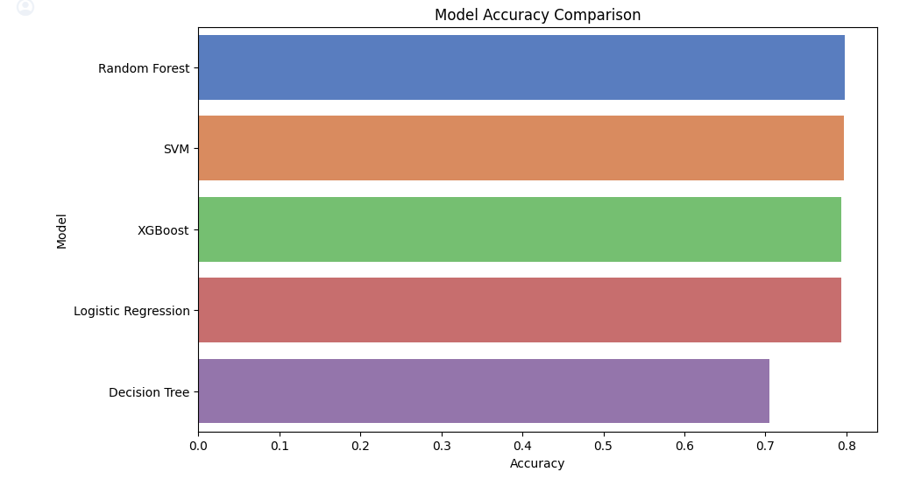
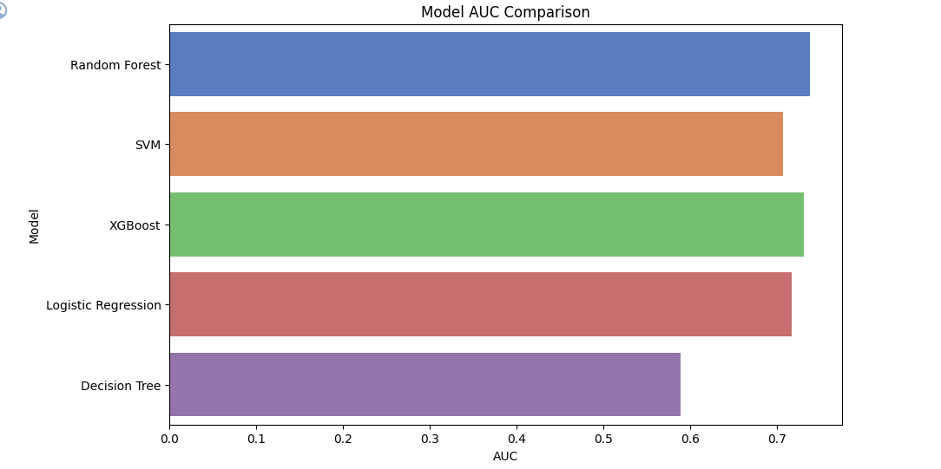
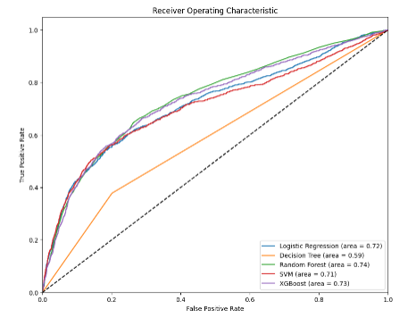
MODEL 4:
The bar chart shows that Random Forest is the top-performing model in terms of accuracy, followed closely by SVM, XGBoost, Logistic Regression and Decision Tree models exhibit lower accuracy in comparison, with the Decision Tree showing the least accuracy among the evaluated models.
The AUC comparison chart illustrates that XGBoost and Random Forest have the highest Area Under the Curve (AUC), indicating superior performance in distinguishing between the classes. Decision Trees has the lowest AUC, suggesting they may not be as effective in this classification task.
ROC Curve Analysis:
Random Forest and XGBoost both present an AUC of 0.74 and 0.73 respectively, indicating comparable performance in true and false positive rates.
Decision Tree follows with an AUC of 0.59, suggesting decent predictive ability but not as strong as the ensemble models.

Slide 20
Result Comparison

Slide 21
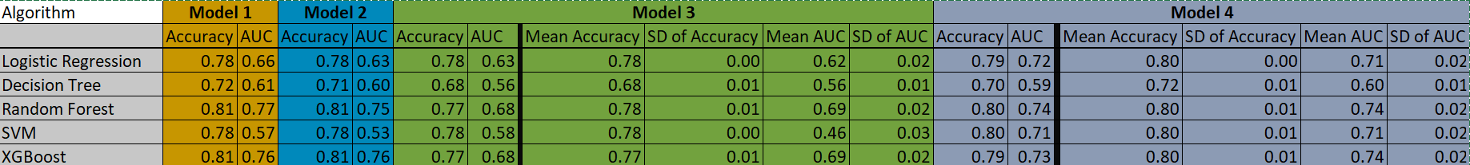
RESULTS: Models and K-Fold
ROC Curve
Model 1
Model 2
Model 3
Model 4

Slide 22
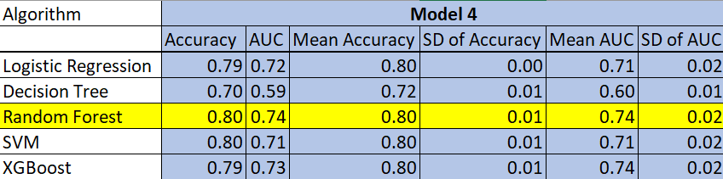
Recommendation:
Considering the evaluation metrics of Accuracy, area under the receiver operating characteristic curve (AUC), and Consistency, our recommendation is to proceed with Model 4, which utilizes a Random Forest algorithm. This model is further enhanced through feature engineering via Principal Component Analysis (PCA).

Slide 23
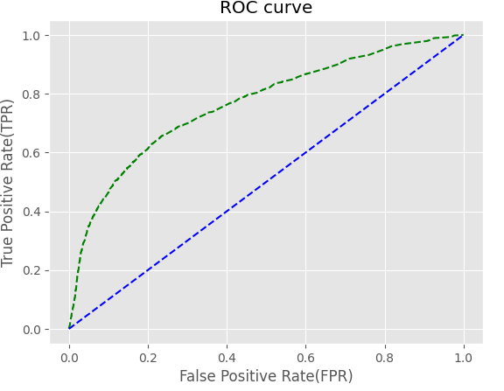
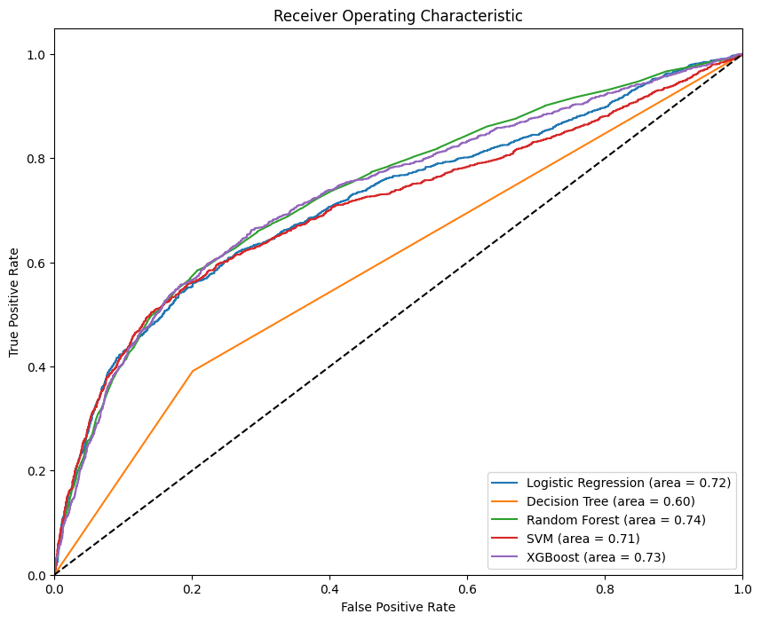
Comparison with Model on Kaggle
https://www.kaggle.com/code/satyamsss/credit-card-default-prediction-82-accurate/notebook#Model-Evaluation
Kaggle
UConn
Best Model Ada Boost Random Forest
Accuracy 81.96% 80%
AUC Not Given 74%
K Fold SD Not Given 1%
Pre-processing Yeo-Johnson Principal Component Analysis

Slide 24
THANK YOU

